Slide 1
MATH 3342: Statistics for Scientists and Engineers
Introduction and Section 1.1

Slide 2
What is Statistics?
What do you think of when you hear “statistics” ?

Slide 3
Wikipedia
Merriam-Webster dictionary defines statistics as "a branch of mathematics dealing with the collection, analysis, interpretation, and presentation of masses of numerical data."^{[6]}
Statistics is a mathematical body of science that pertains to the collection, analysis, interpretation or explanation, and presentation of data,^{[8]} or as a branch of mathematics.^{[9]}Some consider statistics to be a distinct mathematical science rather than a branch of mathematics.
Notes:
https://en.wikipedia.org/wiki/Statistics

Slide 4
What is Statistics?
Statistics is the science of collecting, organizing, summarizing, and interpreting data.
It is also said to be the science of learning from data.
Data: Information or facts that describe a group of interest
Not “just” numbers!
Context is key!

Slide 5
What I think of…
Marketing and Politics
Conducting surveys to obtain opinions and feedback
Public Health
Identifying sources of disease
Testing new drugs and treatments for diseases

Slide 6
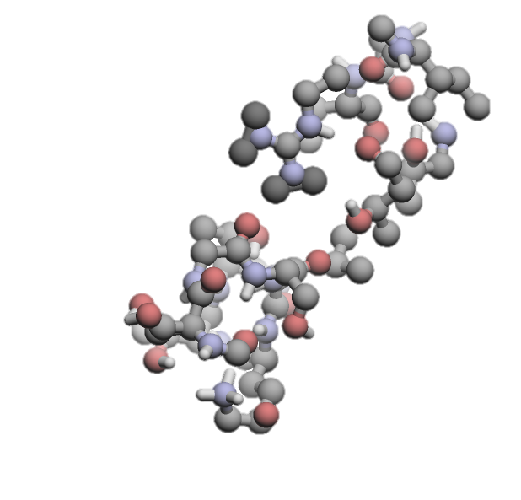
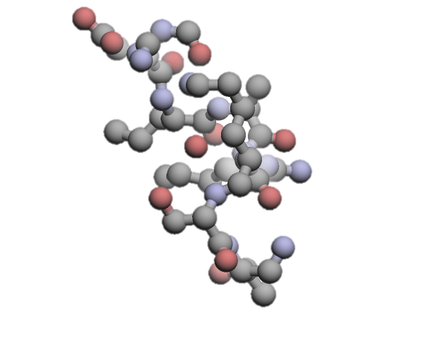
What I think of…
Bioinformatics and Molecular Biology
Developing new drugs and treatments
Studying the human genome
Using protein structures to predict protein functions

Slide 7
What I think of…
Civil Engineering
Assessing effects of stress on structural elements
Studying impact of traffic flows on communities
Materials Engineering
Studying properties of treatments to slow corrosion

Slide 8
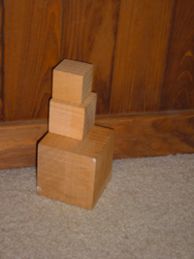
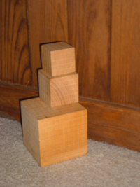

What I think of…
Image and Shape Analysis
Facial recognition
Checking if a product was correctly made according to a blueprint
?

Slide 9
What I think of…
Image and Shape Analysis
Distinguishing between objects

Slide 10
Some Questions to Ask Before Producing Data
What is the group of interest?
What information about the group are we interested in?
How do we collect this information?

Slide 11
The Population
The entire group of individuals about which we want to get information.
If we can quickly and/or cheaply do so, we perform a census:
The collection of data from every member of a population.
Often, it is too time-consuming or expensive to obtain data for the entire population.
How do we get around these constraints?

Slide 12
The Sample
The subset of the population from which we actually collect data.
Selected according to some prescribed manner.
For this sample data, we:
Organize
Describe
Analyze

Slide 13
Example
Each week, the Gallup Poll questions a group of 1500 adult U.S. residents to determine national opinion on a wide variety of issues.
Population =adults U.S. residents
Sample =1500 adult U.S. residents

Slide 14
Example
The 2000 Census tried to gather basic information from every household in the United States. A “long form” requesting much more information was sent to about 17% of households.
Population = every household in the United States
Sample = 17% of households in the United States

Slide 15
Example
There are reports that variation in output voltage from regulator devices is affecting the performance of the complete product. To assess this, 5 regulators are sent to the lab for study.
Population = all regulator of this product
Sample = 5 regulators sent to the lab

Slide 16
How do we describe objects in a data set?
A variable is any characteristic whose value may change from one object to another in a population.
Univariate data
Observations on a single variable
Bivariate data
Observations on each of two variables
Multivariate data
Observations made on more than one variable

Slide 17
Two Branches of Statistics
Descriptive Statistics:
Summarize and describe key features of the data
Includes graphical methods and calculation of numerical summary measures
Discussed in Ch. 1
Inferential Statistics:
Generalize and draw conclusions about the population from the sample data
Discussed in Ch. 6 - 16

Slide 18
The Process of Statistical Analysis
Population
Sample
Descriptive Statistics
Too large/costly to describe directly
Inferential Statistics
Draw conclusions about the population from the sample

Slide 19
Conclusions are Uncertain!
Variation is everywhere.
Is a 1% increase in profit due to changes or just a result of natural fluctuations?
The data we have might not tell the full story.
Is there crucial information we don’t have that may explain the results?
How do we choose our samples to get the “best” samples?
Random sampling!
Probability helps us understand randomness
Ch. 2 - 5

Slide 20
Simple Random Samples (SRS)
Every possible sample of a specified size has an equal chance of being selected.
Every individual also has an equal chance of being selected for the sample.

Slide 21
Example
Researchers wish to test a promising weight loss medication on a group of overweight persons. The list below needs to be randomly divided into two groups: a treatment and control group.
01
02
03
04
05
06
07
08
09
10
11
12
13
14
15
16
17
18
19
20

Slide 22
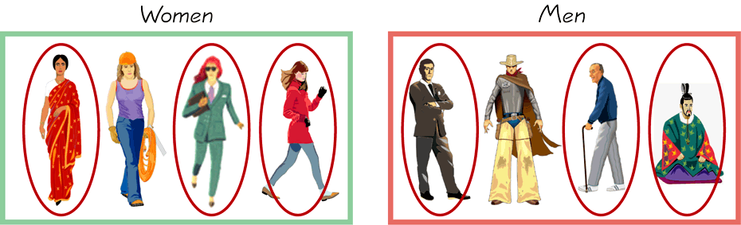
Stratified Sampling
First, divide the population into at least two subgroups.
All of the individuals in each subgroup should share some common characteristic.
The subgroups are called strata.
Then draw a SRS from each subgroup.

Slide 23
Poor Sampling Methods
Voluntary Response Samples
Respondents choose whether to be included in the survey or not
Example: A poll on a website
Convenience Samples
Researcher samples those who are readily available/willing
Example: Polling only the students who sit near you in class

